Slide 1
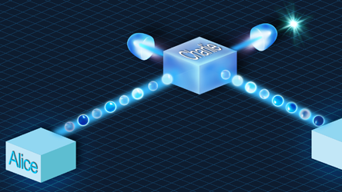
Update meeting 4
Joan, Juan & Timo

Slide 2
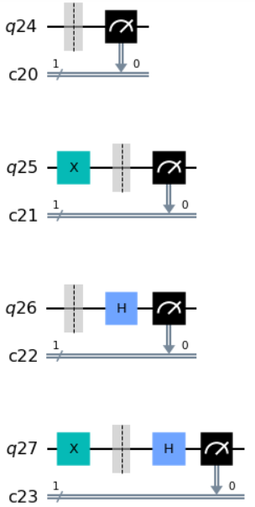
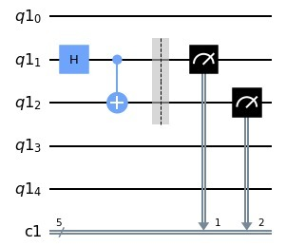
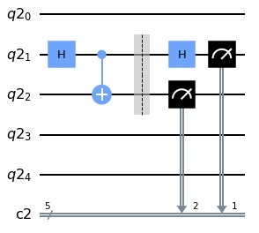
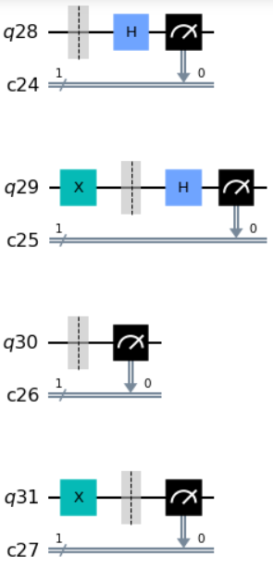
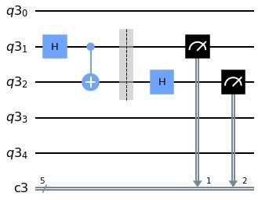
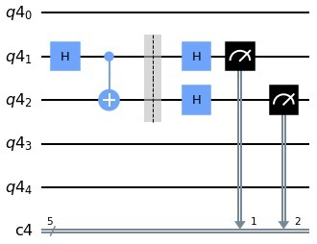
BB84
E-91

Slide 3
Alice Message | 0 |  |  |  |  |  | 0 |  |  |  |  |  | 0
Alice Basis | 0 |  |  |  |  |  | 0 |  |  |  |  |  | 1
Bob Basis | 0 |  |  |  |  |  | 1 |  |  |  |  |  | 0
Bob Message (measured) | 0 | 1 | 0 | 0 | 0 | … | 1 | 0 | 0 | 1 | 1 | … | 0 | 1 | 0 | 1 | …
16384
16384
16384
Shuffle
Alice Message | 0 | 1 | 1 | 1 | 0 | 0 | 1 | 0 | 0 | 1 | 1 | 0 | 0 | 1 | 1 | 0 | …
Alice Basis | 1 | 0 | 0 | 0 | 0 | 1 | 0 | 1 | 1 | 0 | 1 | 0 | 0 | 1 | 0 | 1 | …
Bob Basis | 0 | 0 | 0 | 1 | 0 | 0 | 0 | 0 | 0 | 0 | 0 | 1 | 1 | 1 | 0 | 0 | …
Bob Message (measured) | 0 | 1 | 1 | 0 | 0 | 0 | 0 | 1 | 1 | 1 | 0 | 1 | 0 | 0 | 1 | 1 | …
RECAP

Slide 4
Alice Message | 0 |  |  |  |  |  | 0 |  |  |  |  |  | 0
Alice Basis | 0 |  |  |  |  |  | 0 |  |  |  |  |  | 1
Bob Basis | 0 |  |  |  |  |  | 1 |  |  |  |  |  | 0
Bob Message (measured) | 0 | 1 | 0 | 0 | 0 | … | 1 | 0 | 0 | 1 | 1 | … | 0 | 1 | 0 | 1 | …
16384
16384
16384
Shuffle
Alice Message | 0 | 1 | 1 | 1 | 0 | 0 | 1 | 0 | 0 | 1 | 1 | 0 | 0 | 1 | 1 | 0 | …
Alice Basis | 1 | 0 | 0 | 0 | 0 | 1 | 0 | 1 | 1 | 0 | 1 | 0 | 0 | 1 | 0 | 1 | …
Bob Basis | 0 | 0 | 0 | 1 | 0 | 0 | 0 | 0 | 0 | 0 | 0 | 1 | 1 | 1 | 0 | 0 | …
Bob Message (measured) | 0 | 1 | 1 | 0 | 0 | 0 | 0 | 1 | 1 | 1 | 0 | 1 | 0 | 0 | 1 | 1 | …
Majority voting gives a 1 in this case
This leaves a key length of 8*16384/10
RECAP

Slide 5
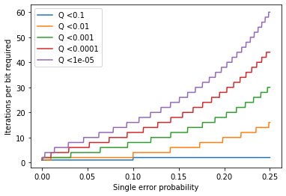
How many iterations are necessary?
RECAP

Slide 6
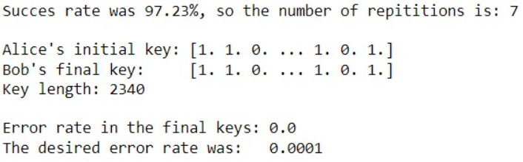
How does it work on Starmon-5?

Slide 7
How does it work on Starmon-5?
(Using half of the bits)

Slide 8
How does it work on Starmon-5?
After Majority voting
(with 7 bits per logical bit)

Slide 9
How does it work on Starmon-5?
Comparing the final keys will always
give an error lower than a desired
error (which is an input parameter)

Slide 10
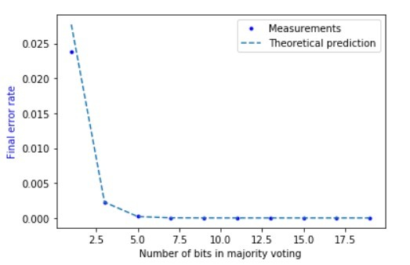
How effective is the repitition code?

Slide 11
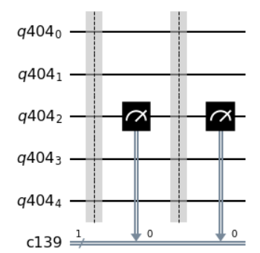
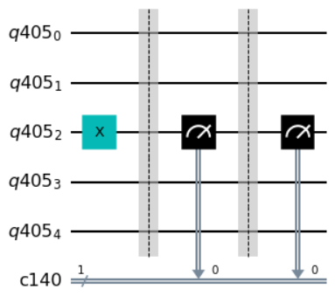
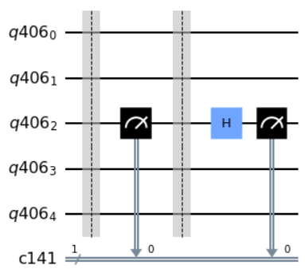
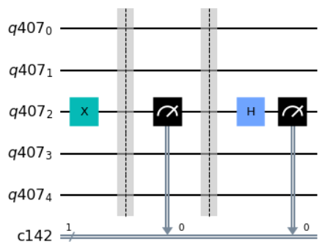
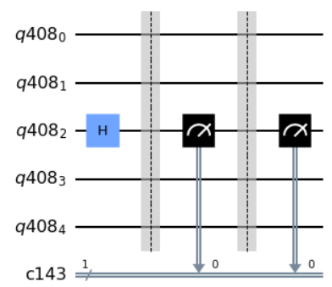
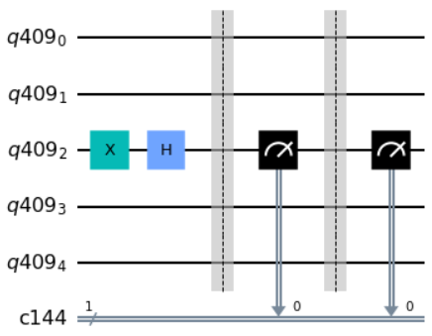
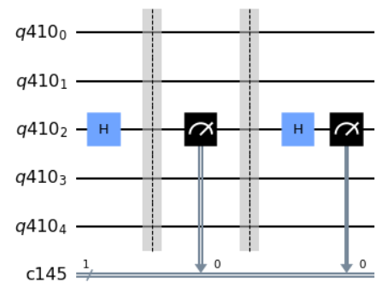
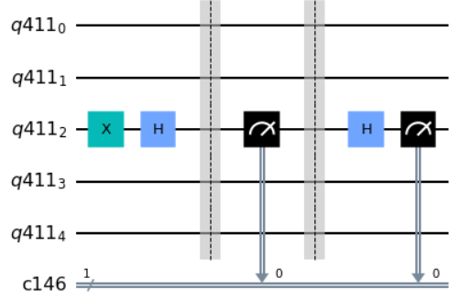
Now let’s add Eve (BB84)

Slide 12
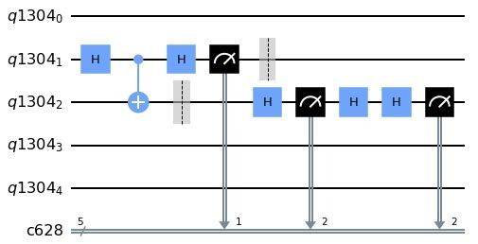
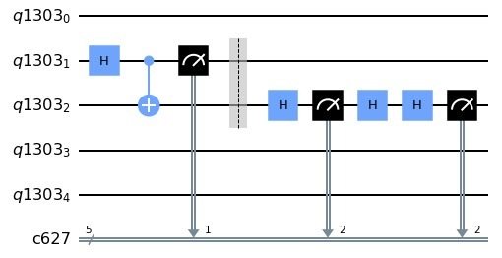
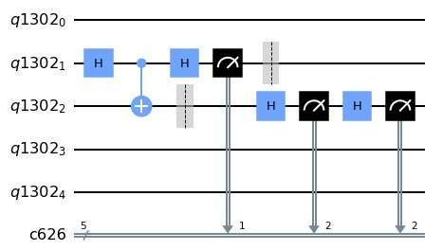
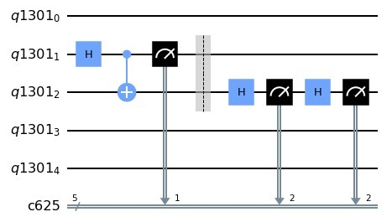
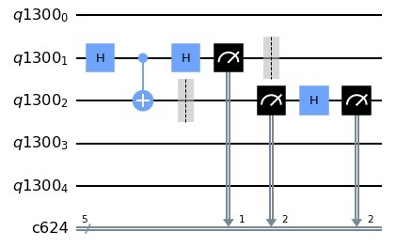
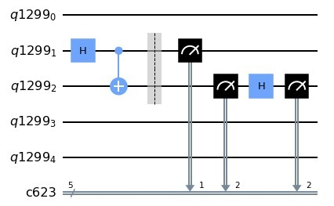
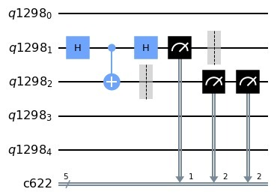
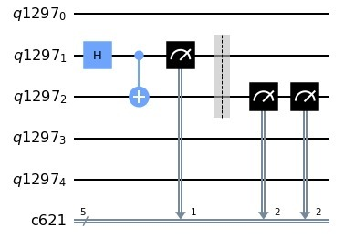
Now let’s add Eve (E91)

Slide 13
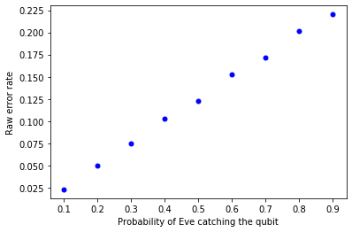
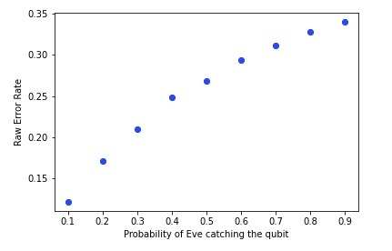
Exposing Eve
BB84
E91

Slide 14
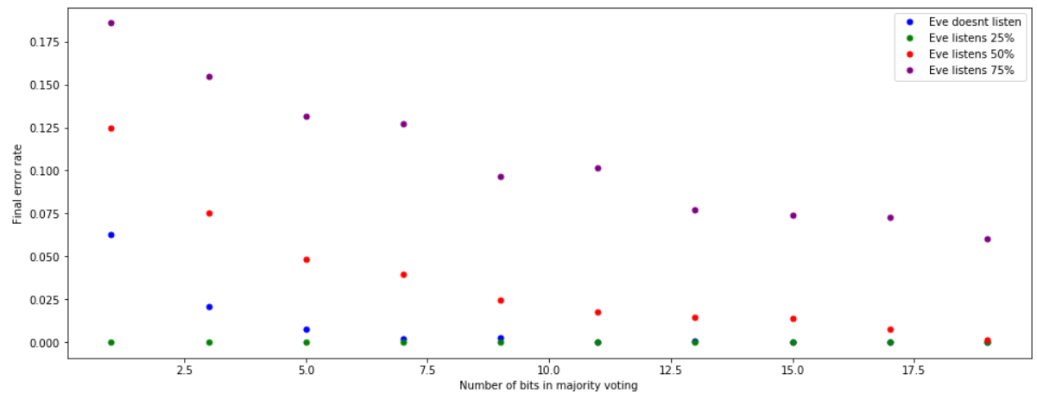
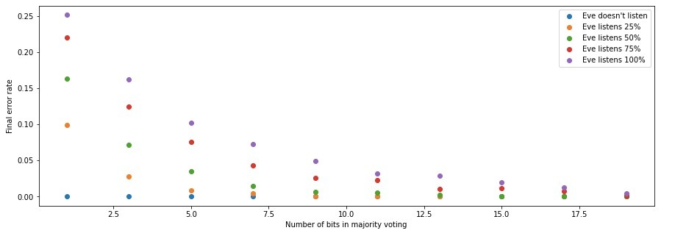
What happens if we do repetition code now?
BB84
E91
(In simulator)

Slide 15
Overview
Done
Gathered a lot of data…
To Do (this week)
Questions
What do you think of our results? And are you missing certain aspects?
Everything on Starmon-5 that hasn’t been done on Starmon-5
A bit of theoretical work on privacy amplification

Slide 16
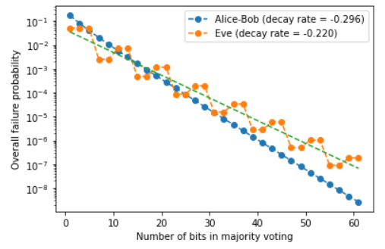
Theoretical research
How many iterations do we need when Eve is listening to still get a good key with privacy amplification?

